Slide 1
Technology
Advancements
in
Jet Air Transport Operations
David Morgan
Air New Zealand & IATA

Slide 2
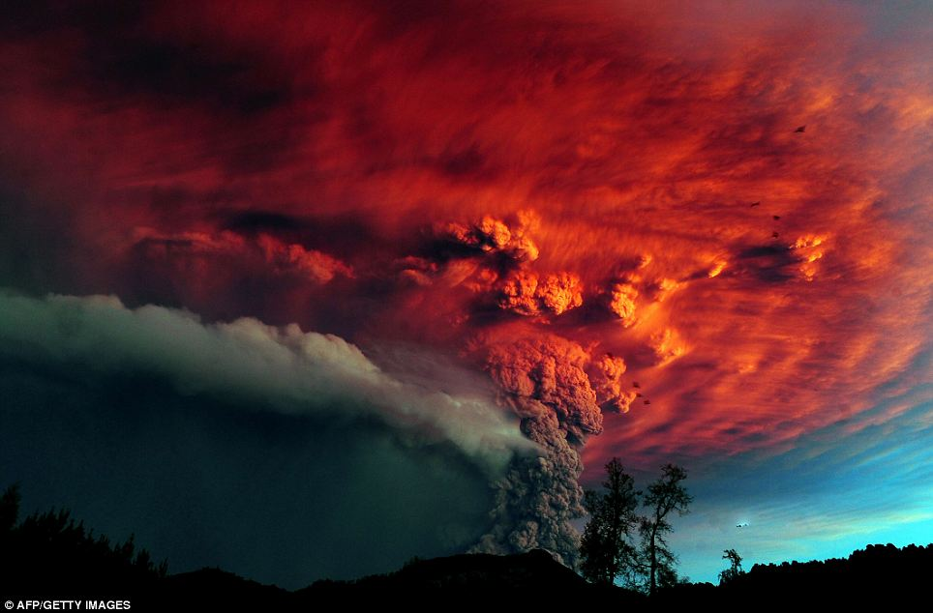
Risk
y
10⁻⁹
2
Notes:
2

Slide 3
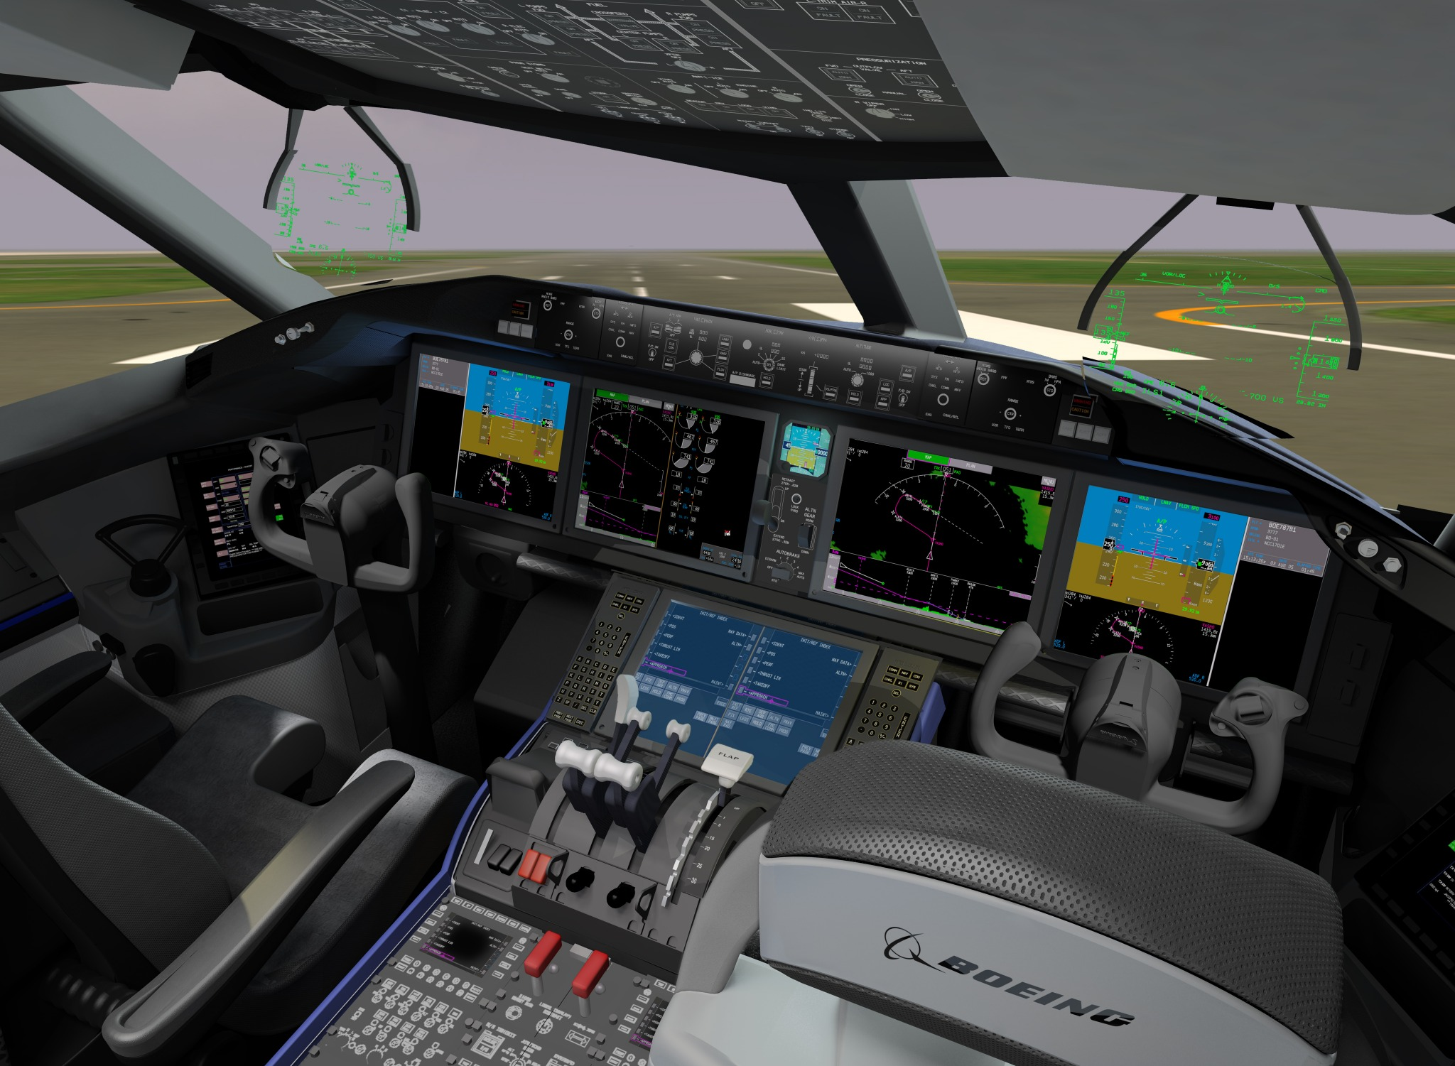
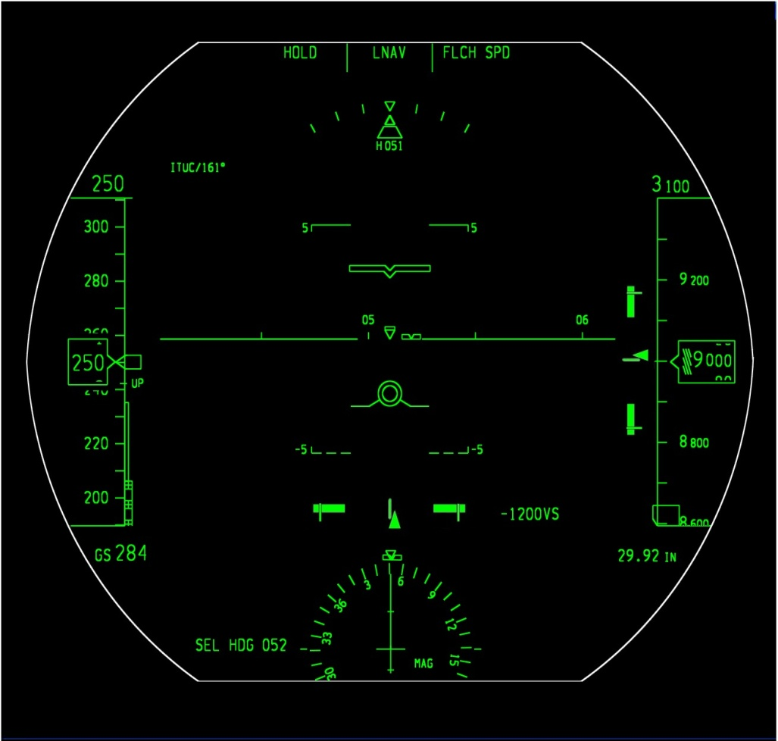
COPYRIGHT © 2005 THE BOEING COMPANY

Slide 4
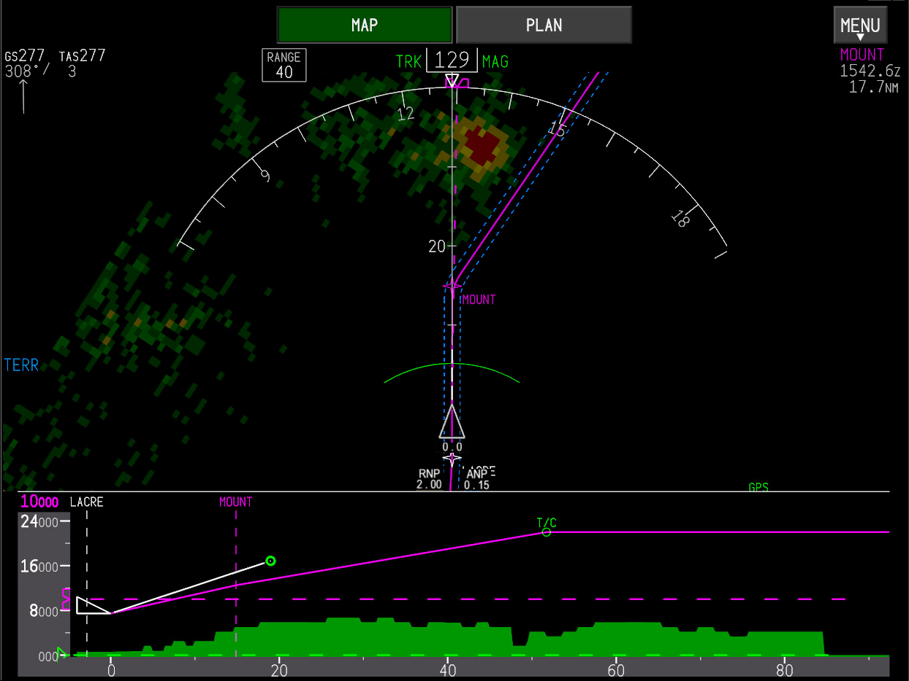

Slide 5
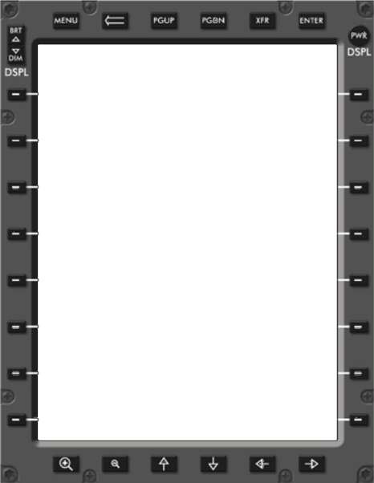
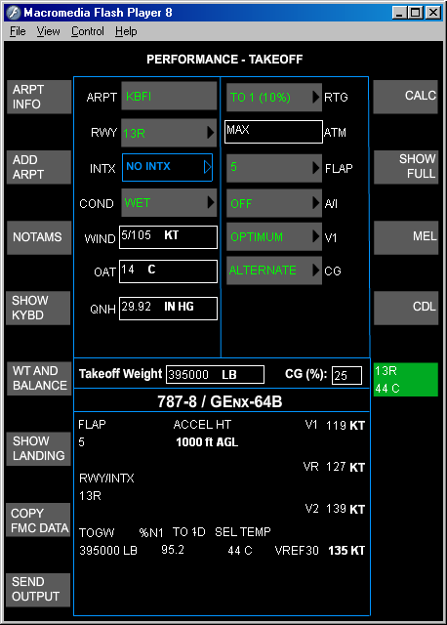
100/05
BOEING PROPRIETARY COPYRIGHT © 2005 THE BOEING COMPANY
EAR Data ECCN 9E991

Slide 6
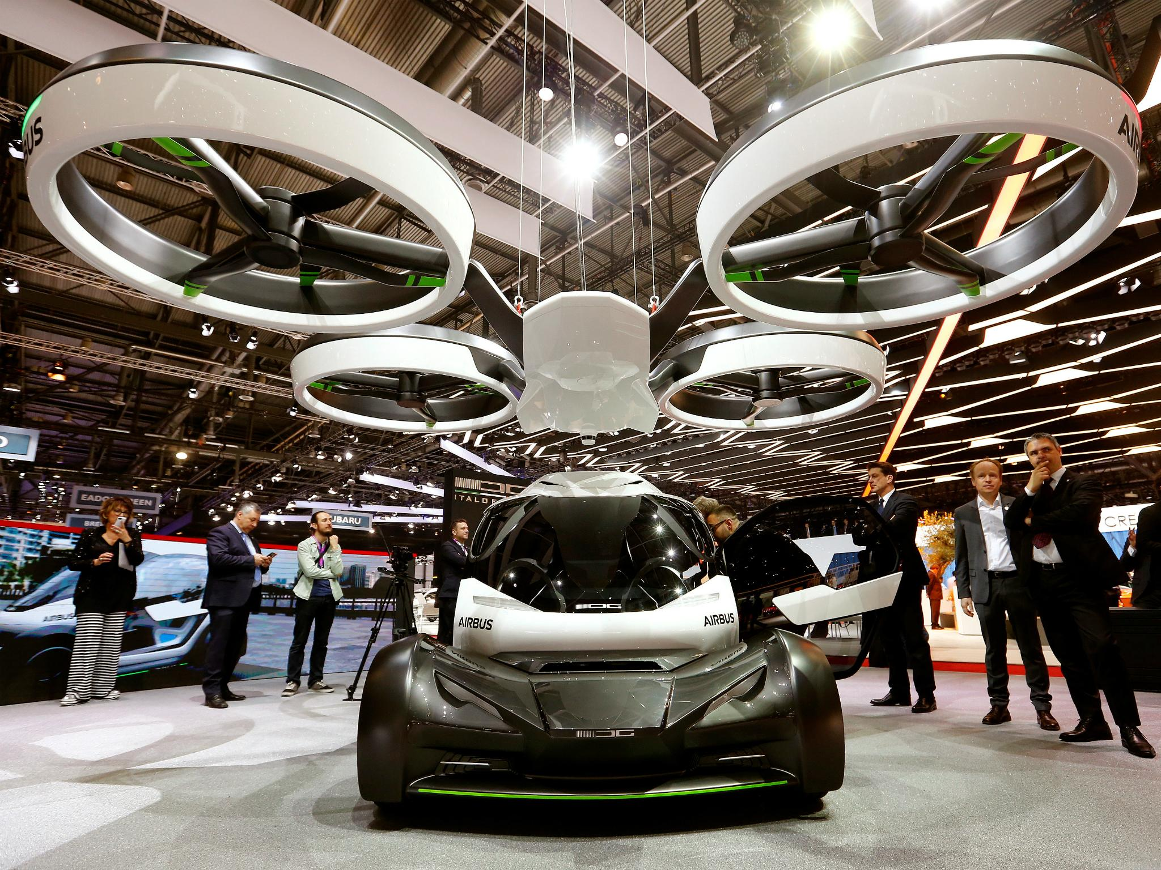
Notes:
6

Slide 7
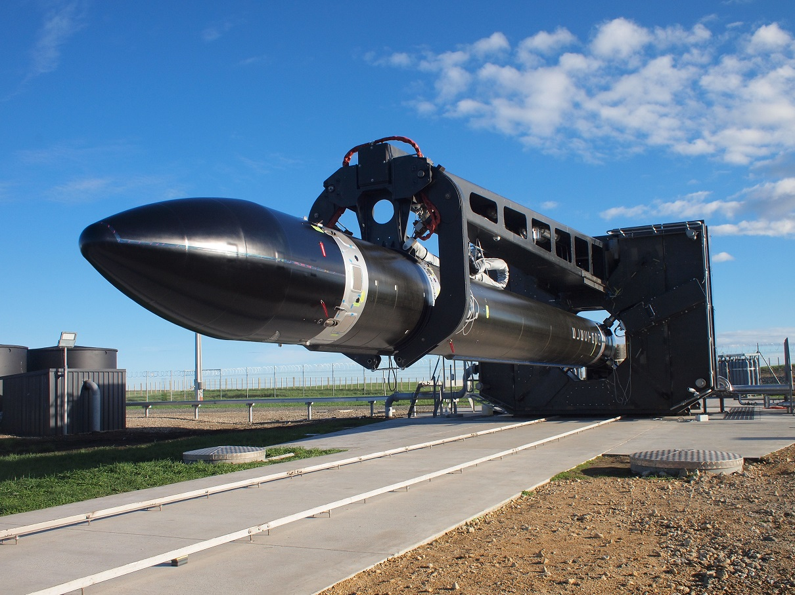
Notes:
7

Slide 8

Notes:
8

Slide 9
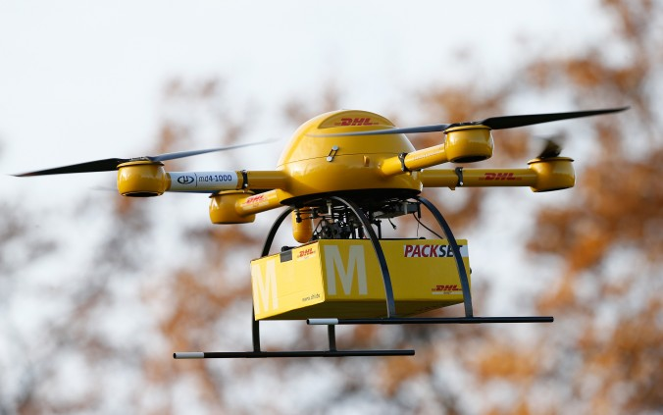
Notes:
9

Slide 10
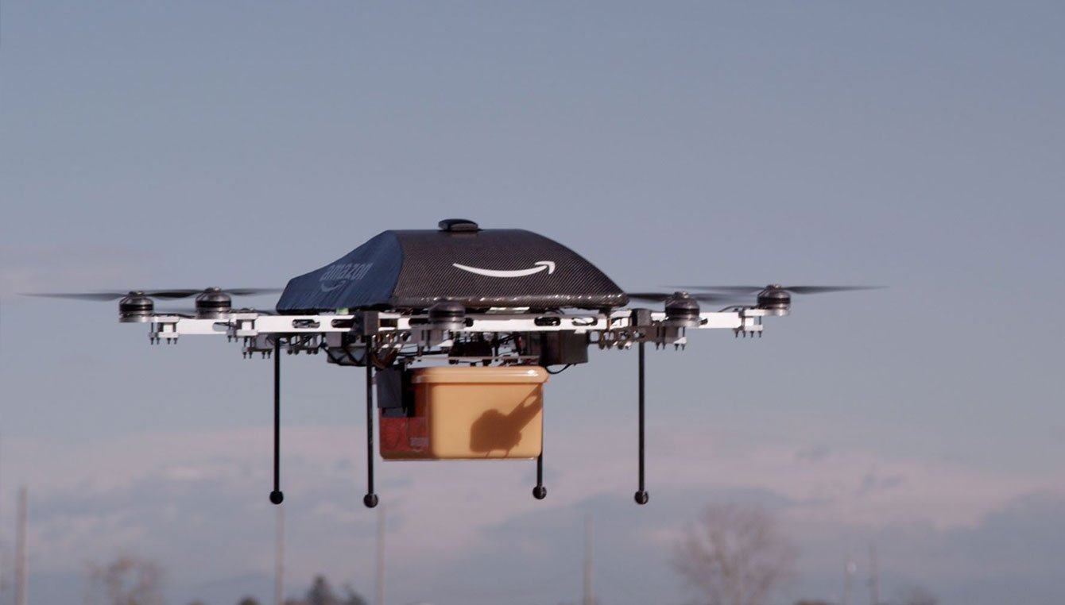

Slide 11


Innovate
Collaborate
Drive change
Notes:
Before we get into where we are headed – I want to take a moment to reflect on where we’ve been.
Our airline is an aviation icon in New Zealand and overseas. We have relentlessly innovated and redefined what it means to be the best airline in the world. Air New Zealand is a great kiwi company and we should all be proud of the role we’ve played in shaping our nation so far…

Slide 12
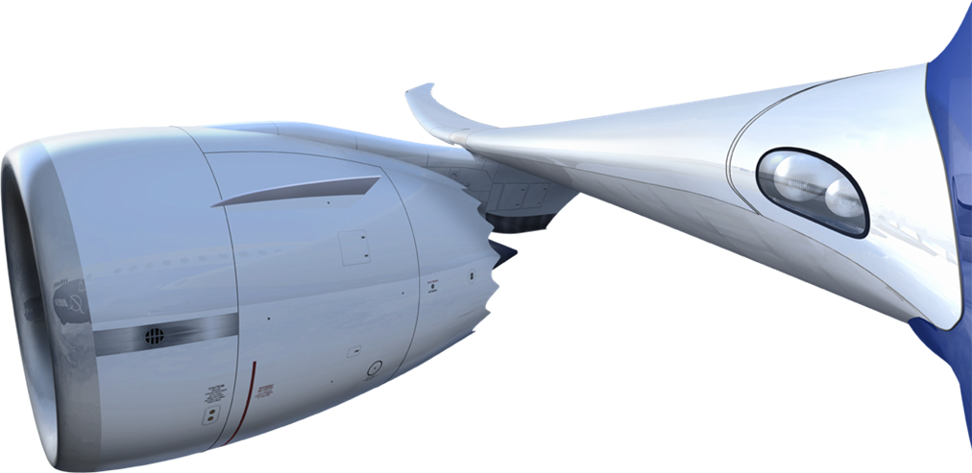
Thank You

